Slide 1
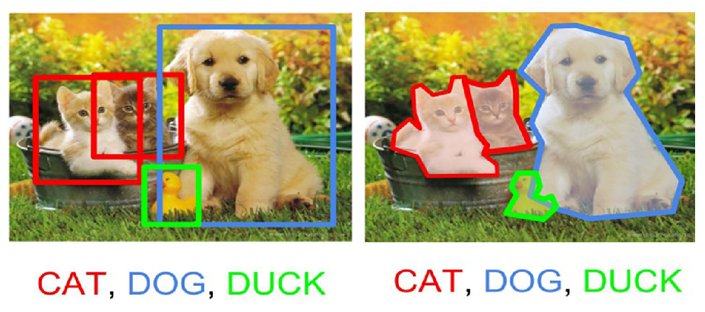
Object Detection
Aayush Sisodia,
Aswani Gollakota,
Jayashree Ganesh Kumar,
Puja Doshi,
Saranya Jeevanandam,
Stephen Holsenbeck
Team 6
Manali Sharma, Aswani Gollakota

Slide 2
Content
Project Outline
Design & Methodology
Acceptance Criteria
Image Classification
Object Detection Train
Object Detection Test
Challenges & Limitations
Future Scope

Slide 3
Project Outline and Goal
Object detection is a computer technology related to computer vision and image processing that deals with detecting instances of semantic objects of a certain class (such as humans, buildings, or cars) in digital images.
Goal:
This project is an attempt at developing an object detection model using modern computer vision technology. The project aims to incorporate state-of-the-art techniques for object detection with the goal of achieving high accuracy in detecting objects.
Input:
ImageNet dataset
Output:
Identified Objects (Persian cat, Mountain bike, Lizard, Turtle etc.) maximum 4 objects will be detected in given
Image
Reference:
https://www.kaggle.com/c/imagenet-object-localization-challenge/data

Slide 4
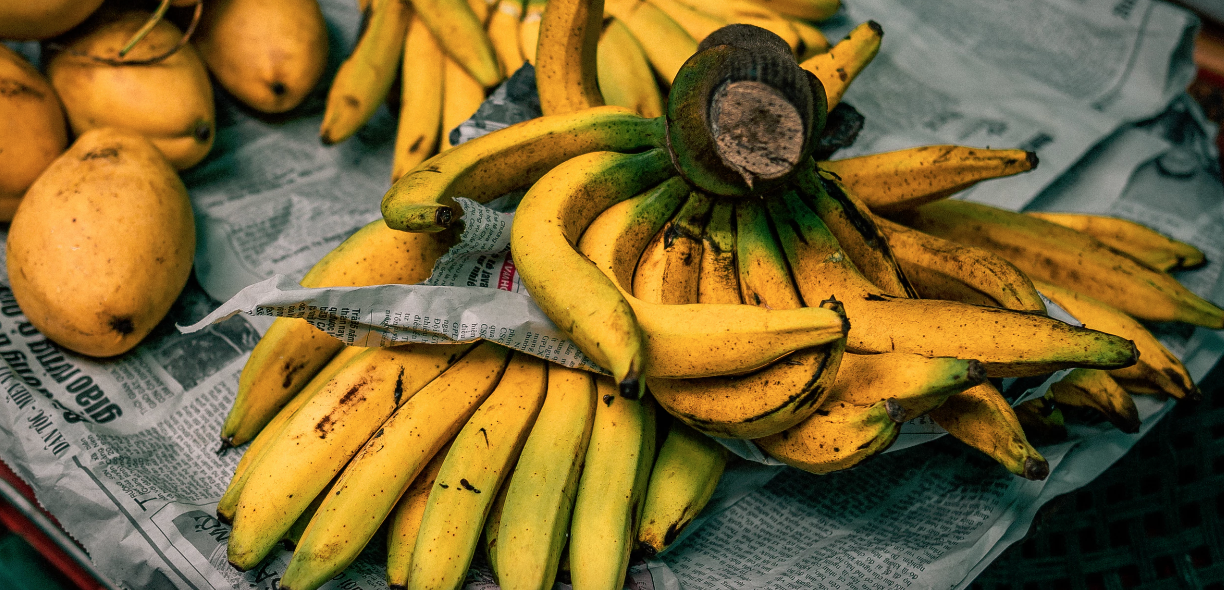
Use case
Use case:
Detection up to 4 objects in given image
Input: ILSVRC2012_val_00048981.jpeg
Output: Mango Banana
(in this case this image has 2 objects)
Training dataset:
50000
Validation Dataset:
20000

Slide 5
Why scala with spark
Scala has as set of features that make it particularly well suited for building neural networks. Its functional nature and expressiveness is ideal for elegant composition of tensor operations and neural network architecture.
Scala's syntax and its type inference enables expressing tensor operations in a concise and readable way. At the same time, its powerful static type system can help catching certain kinds of errors early on at compile time, adding safety and often making development and especially maintenance more productive. Scala is oftentimes fun to program in.
Spark:
Spark Mllib(Machine Learning Library) is more suitable for big data deep learning that store data across a cluster of nodes. Spark is able to run programs over faster when running on disk. Spark has a complex DAG or Directed Acrylic Graph) execution engine that provides support for cyclic data flow and in-memory data sharing across DAGs to carry out different jobs with the same data.
So scala with spark will be better combination to use for the current project, given the size of the data and the complexity of the algorithm.

Slide 6
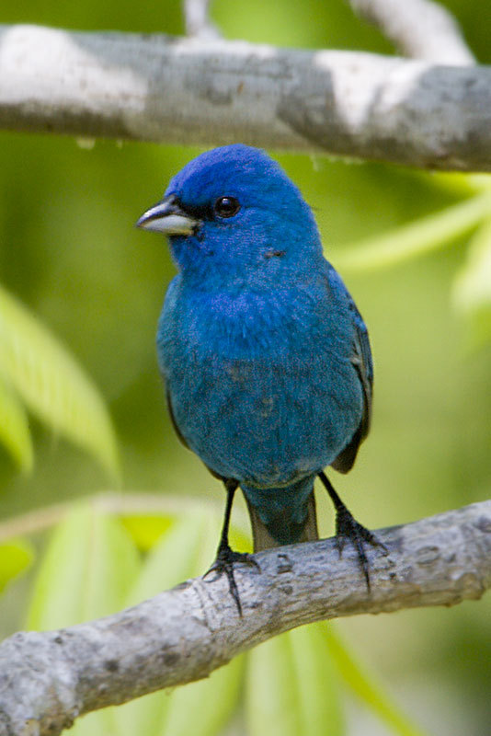
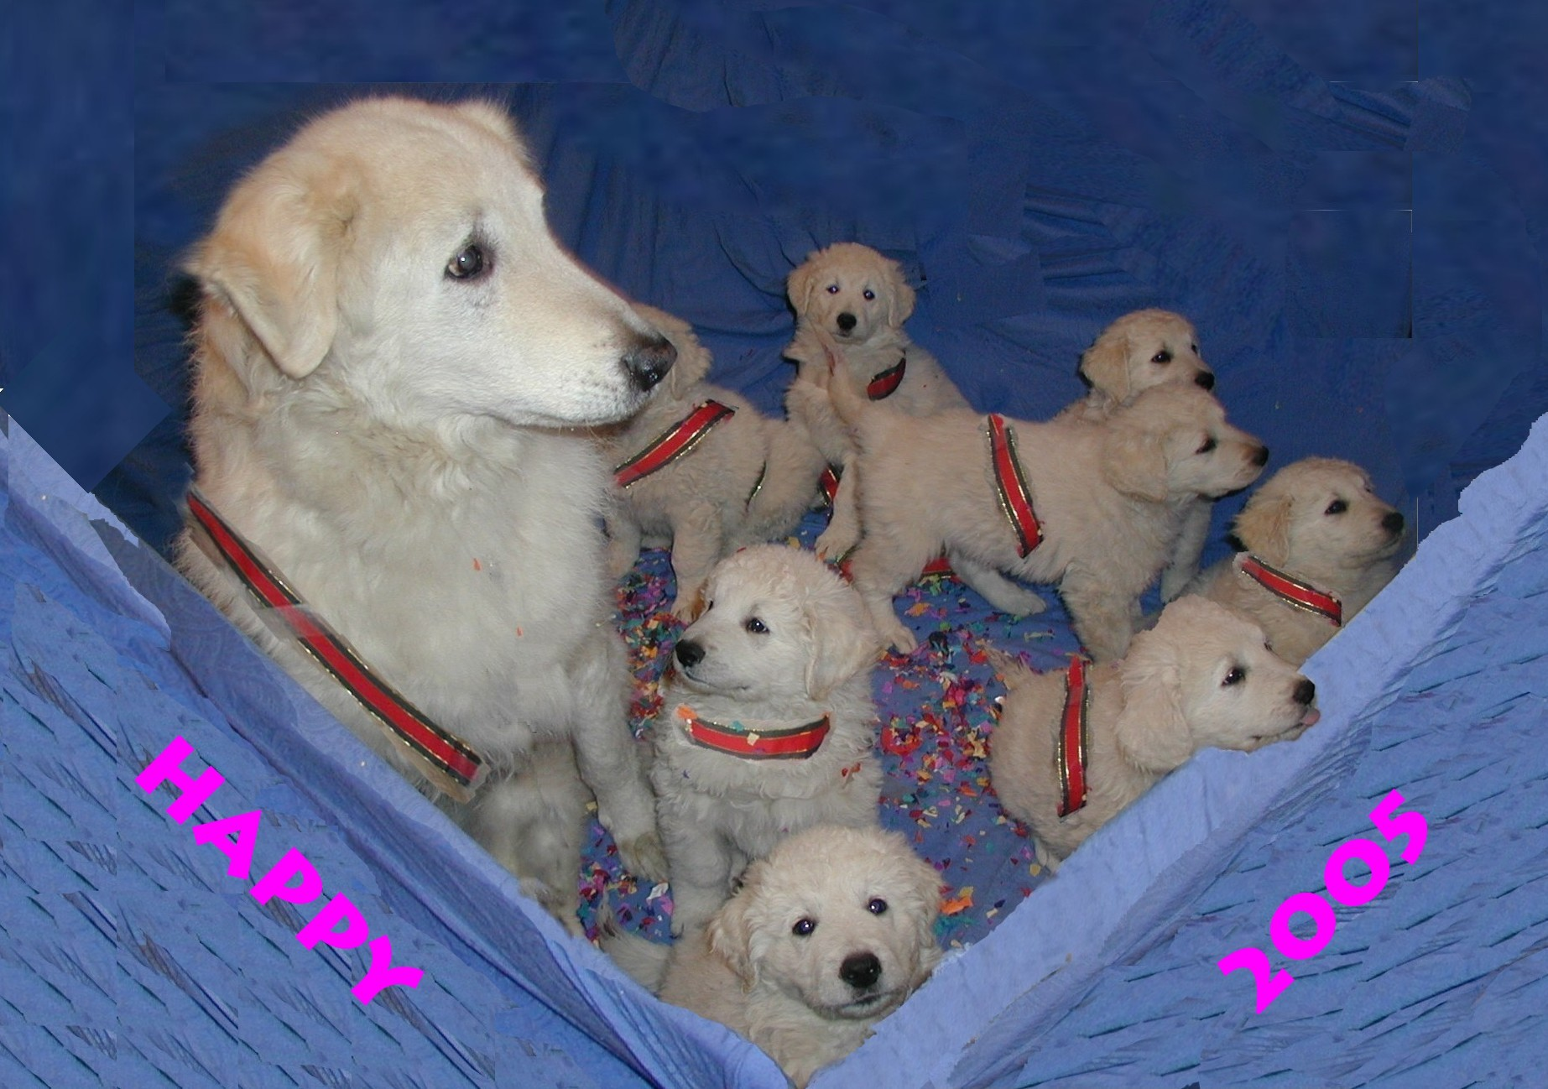
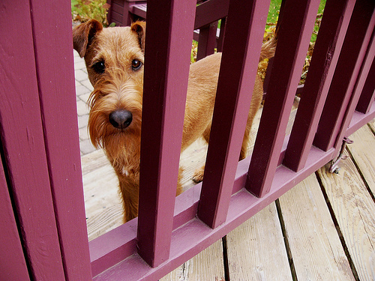
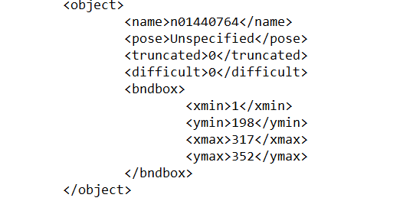
Data source
Data source:
ImageNet dataset
Labels:
Image wnid(1000) along with images. Wnid and the object name is saved in text file.
e.g. n02119022 red fox, Vulpes vulpes
Annotation file : Consists of object boundaries
Overall size:
154GB
Average image size: 200KB
Tools & Technology:
Scala with spark, S3 or HDFS (probable database)

Slide 7
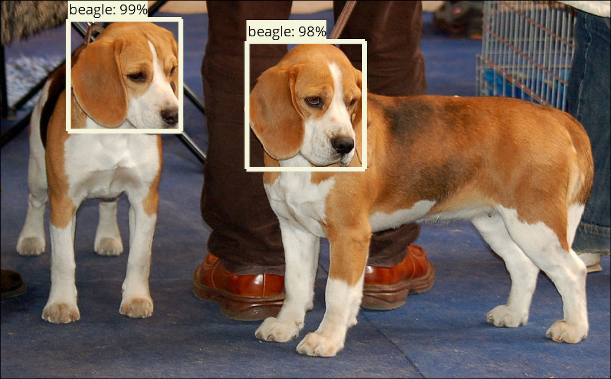
Acceptance criteria
Acceptance Criteria:
Mean Average Precision, is particularly used for algorithms where we are predicting the location of the object along with the classes. Along with it the image
detection accuracy should be as below
Single object detection : 80% (probability)
Sequence/multiple object detection : 70% (probability)

Slide 8
Design and Methodology
Prepare the training data (collect, pre-process, vectorise etc.)
Divide the data into training set/cross-validation set/test set for evaluation.
Create the neural network architecture.
Define the types, number and size of layers.
Define other hyper parameters such as loss function, optimizer, or learning rate.
Train your model on the training data.
Evaluate your model on the cross-validation set. Depending on the results, repeat steps 3-5 with different hyper parameters, or collect more data until you're satisfied with the results.
Do a final evaluation on the test set.

Slide 9

Architecture
Scala libraries considered:
Eclipse Deeplearning4j
ScalNet:
ScalNet is a wrapper around Deeplearning4J emulating a Keras like API for deep learning.
TensorFlow for Scala:
This library is a Scala API for https://www.tensorflow.org
Apache MXNet:
Similar to TensorFlow, MXNet supports creating symbolic computation graphs, decoupling computation logic from execution. Furthermore, it provides support for eager execution as well for a more imperative approach.
Infrastructure/Cluster:
Google cloud or AWS S3 bucket
Notes:
The arrows show how the inputs of a neuron from one layer are connected to the outputs from the previous layer. As you can see in the image, each input is connected to all the outputs of the previous layer, which is why this type of layer is called a fully connected layer. Each neuron has a number of weights or parameters, one for each input, whose values are determined during training. As we've seen in part one, these weights contain the memory of a neural network, and represent what the network has learned. In our case, how it maps the input image to the a digit. The input layer just represents the input values and does not have any weights, nor does it do any computation. In our MNIST example the input is the raw pixels of the image, normalized to have a range between zero and one. So we have 28 * 28 input values, represented as a vector of 784 float values. During a forward pass through the network, each input of a neuron is multiplied by its corresponding weight , and the results of that multiplication are summed up. In our hidden layer, the resulting value is then fed into an activation function called relu that just passes through all positive values but sets any negative number to zero.In the output layer, we use a softmax function instead, which returns a probability score for each of the 10 classes representing digits. The digit with the highest probability is what the network predicts as image content.

Slide 10
Repository and Application criteria
Repository: Github
https://github.com/ManaliSharma/BigData_Scala_Cat_Dog_Duck
Models Trained:
Image Classification
Object detection
Programming:
Images are loaded in S3 (Amazon Web Services)
Spark cluster (ECR: Amazon Elastic Container Registry ) is setup with 3 instances
Scala with spark and Tensors are used to build code base for both Image classification and Object detection

Slide 11
Image Classification
Pre-process functions
Create spark context and read images from S3(AWS). The data is projected in to a predefined range (i.e. usually [0, 1]or [-1, 1]). This is useful when we have data from different formats (or datasets) and we want to normalize all of them so we can apply the same algorithms over them.
Load train and validation data from S3. (Train data is split randomly into train and test) for trained model validation.
Vectorization
Vectorization refers to the process that transforms the original data structure into a vector representation so that the scalar operators can be converted into a vector implementation.

Slide 12
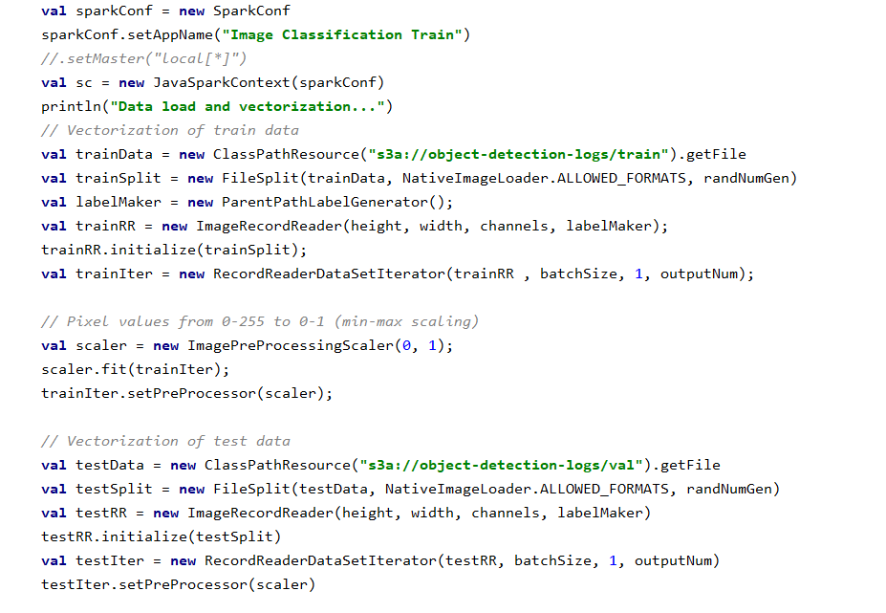
Image Classification
Vectorization

Slide 13
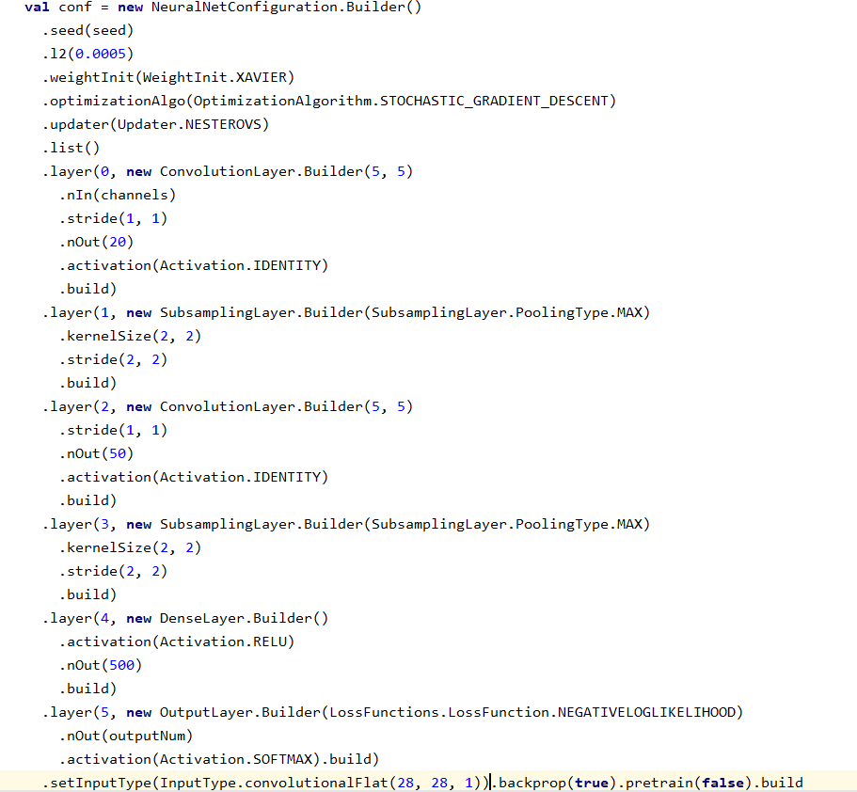
Image Classification
Build the network: Convolution and Max Pooling Layer
we build the model based on deeplearning4j library. here we define the input variables in multi layer network of the library.

Slide 14
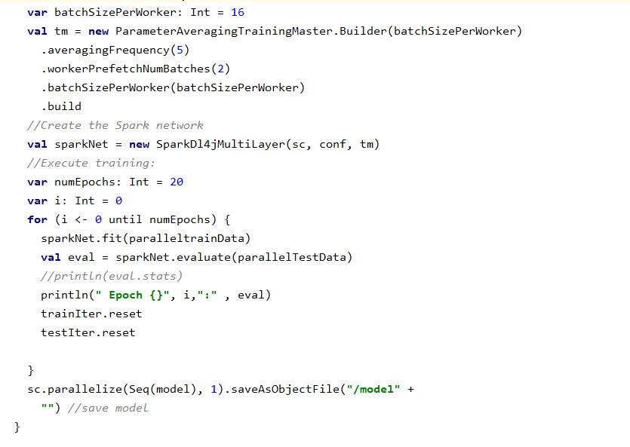
Image Classification
Train and test Model using spark
we build the model based on deeplearning4j library. here we define the input variables in multi layer network of the library. Save the trained model in s3 bucket

Slide 15
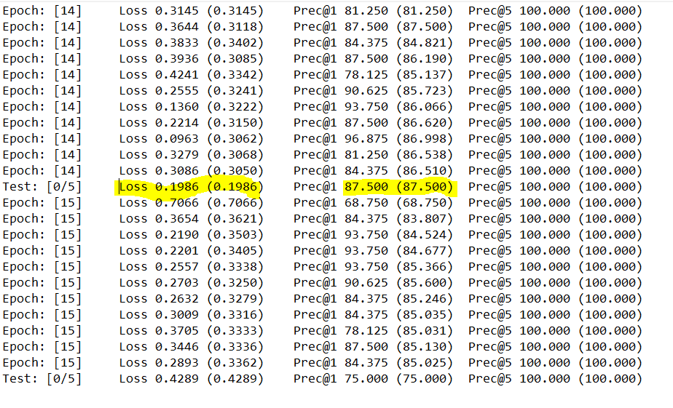
Image Classification
Result
Select the best model by looking the loss value and accuracy. The best model accuracy is 87.5% in current model.

Slide 16
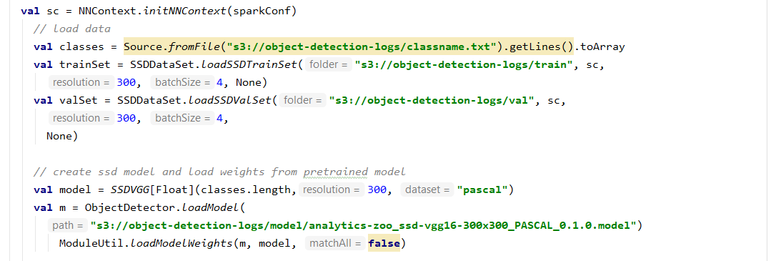
Object Detection-Training
Data Load and processing
Create spark context and read images from S3(AWS). Load train and validation data from S3. (Train data is split randomly into train and test) for trained model validation.
Load pre trained SSD(Single Shot Multibox Detector) model and weights to train using given images.

Slide 17
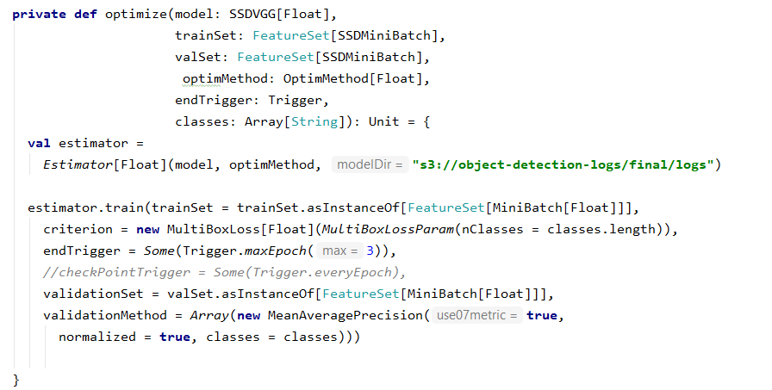
Object Detection - Train
SSD Multibox (short for Single Shot Multibox Detector) is a neural network that can detect and locate objects in an image in a single forward pass. The network is trained in a supervised manner on a dataset of images where a bounding box and a class label is given for each object of interest.

Slide 18
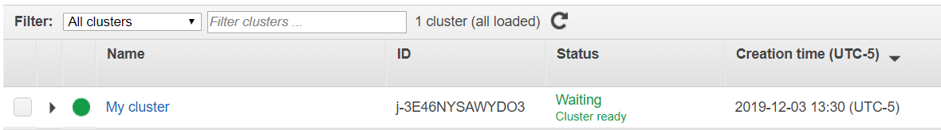
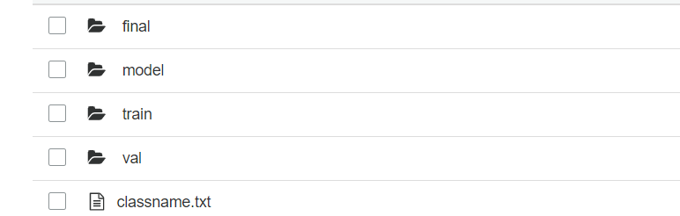
Spark cluster configuration
Spark cluster is created with 3 instances using Amazon Elastic Container Registry (ECR) .
Jar files are created for the scala modules and deployed in the cluster mode in end node.

Slide 19
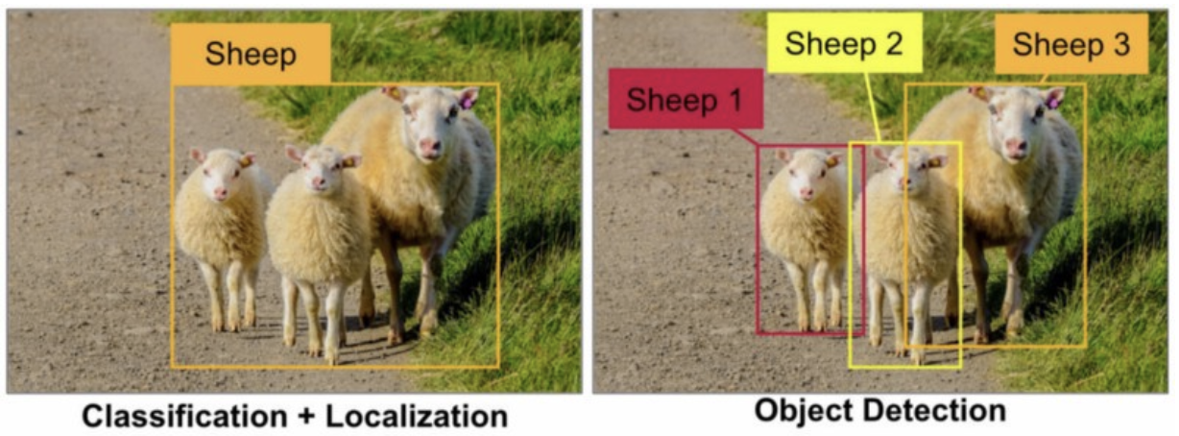
Object Detection
In object detection , we want to predict where one or multiple objects are located in an image. Usually when we do object detection we generally mean classification and localization together. i.e. our neural net is trained in a certain way that it tells the type of image as well as the location of the of the object in image.

Slide 20
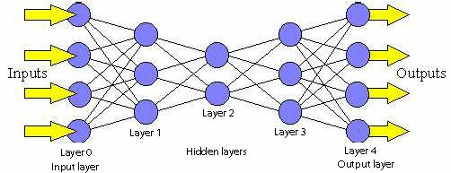
How Neural Net is helping us?
Neural network is trained in such a way that it predicts the coordinates of the rectangle surrounding an object, known as the bounding box, and further it classifies the object within that bounding box. The classification part is almost always done using a convolutional neural network. For the bounding box predictions, several approaches exist with different speed and accuracy characteristics.

Slide 21
Tensor flow
Tensor flow Object Detection API is an open source framework built on top of tensor flow that makes it easy to
construct , train and deploy object detection model
API supports 2 model families SSD and faster R-CNN
Tensor flow OD API is also used to train model for oneself and we have incorporated with our project. Although we used the already existing pre trained model i.e SSD (Single Shot Detector)

Slide 22
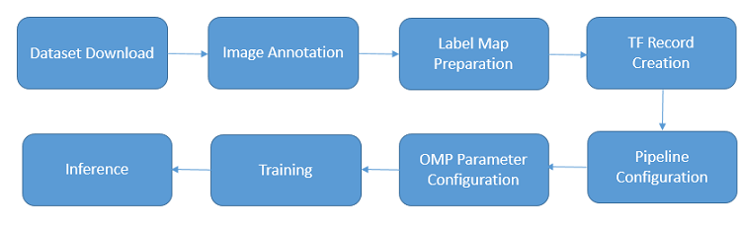
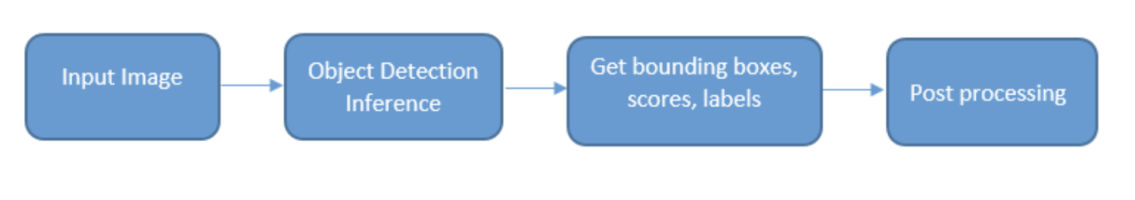
General Architecture of Object Detection Model
General Architecture of Object Detection Model with pre-trained model

Slide 23

Object Detector Class Model Basic Requirements
Computer vision library opencv used for image detection.
Open cv is written in c++, but we have used a JAVA wrapper called JAVA cv.
SBT JAVA cv is an SBT plugin that uses the right open cv dependency for our platform and architecture/
Actual Detection is done using tensor flow for Scala.

Slide 24
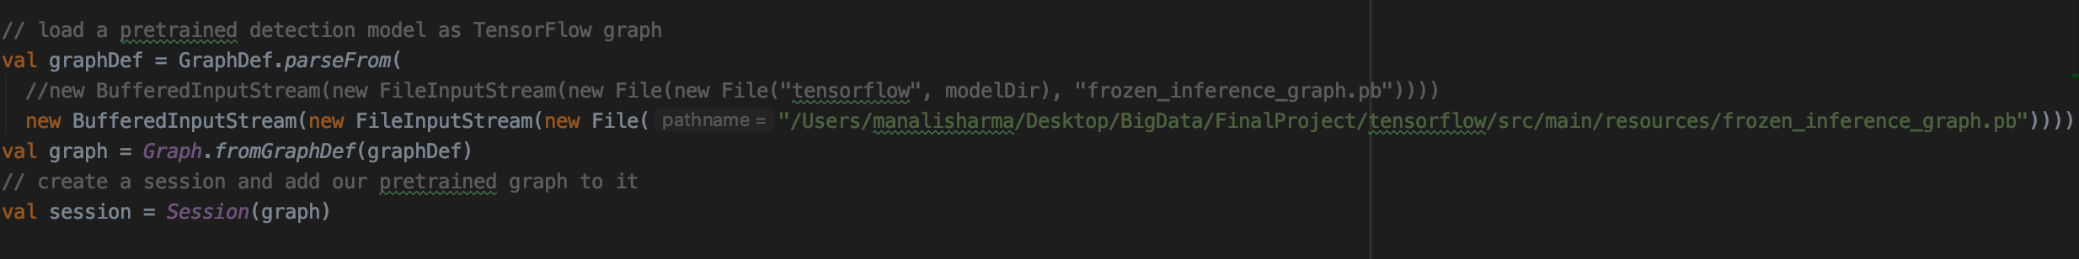
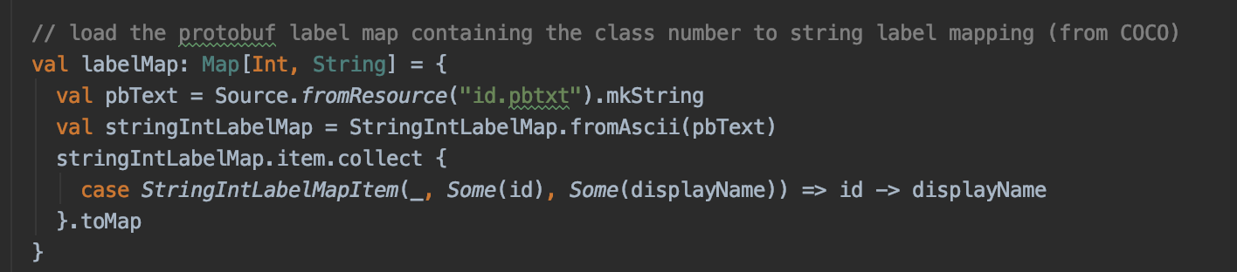
Object detection model
Object Detection Step 1:- Loading Pre-trained Model and Creating tensor flow graph from it
Step 2:- Loads the label from dataset (annotations i.e the .pb files). Labels are encoded as protocol buffers

Slide 25
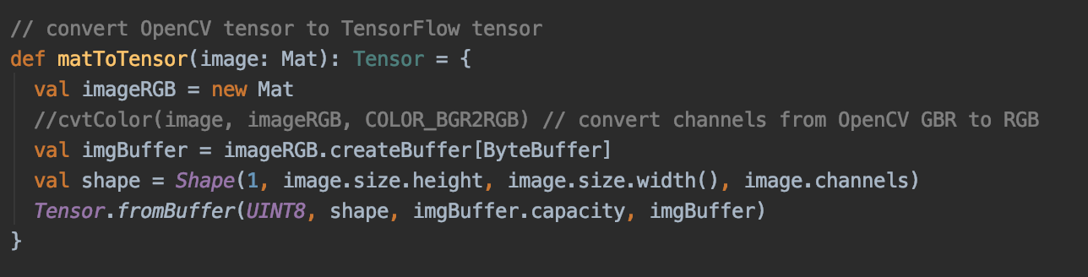
Object Detection model
matToTensor:- Function is defined to convert image from MAT opencv to tensor flow tensor.

Slide 26
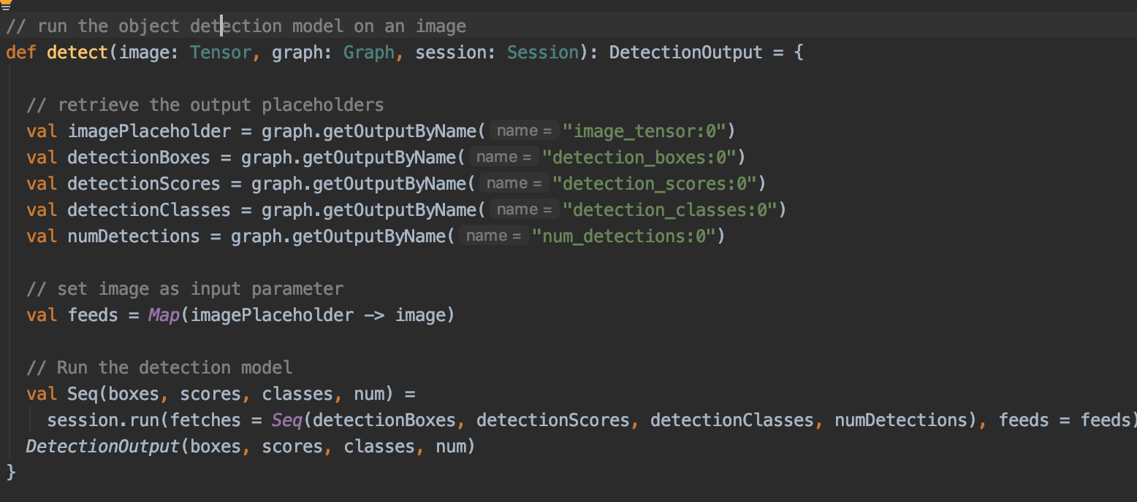
Detecting the object
Values returned through this function given tensors containing the bunch of bounding box coordinates as well as confidence score and classes.
Confidence Score is a threshold that determines what the lowest matching score acceptable to trigger an interaction is. If the matching score falls below the confidence score, the bot will trigger fallback interaction, an interaction that asks the user to repeat the query

Slide 27
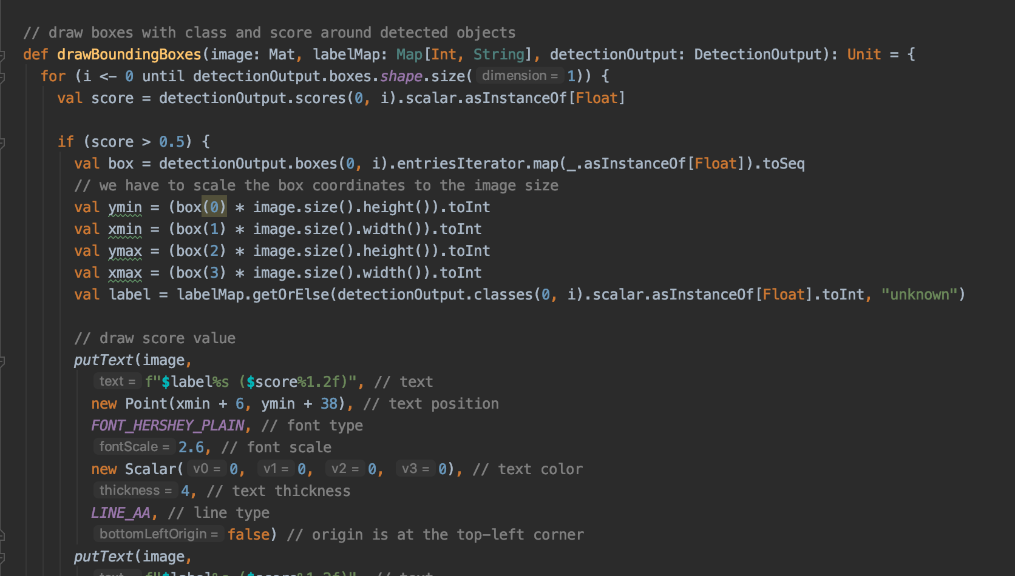
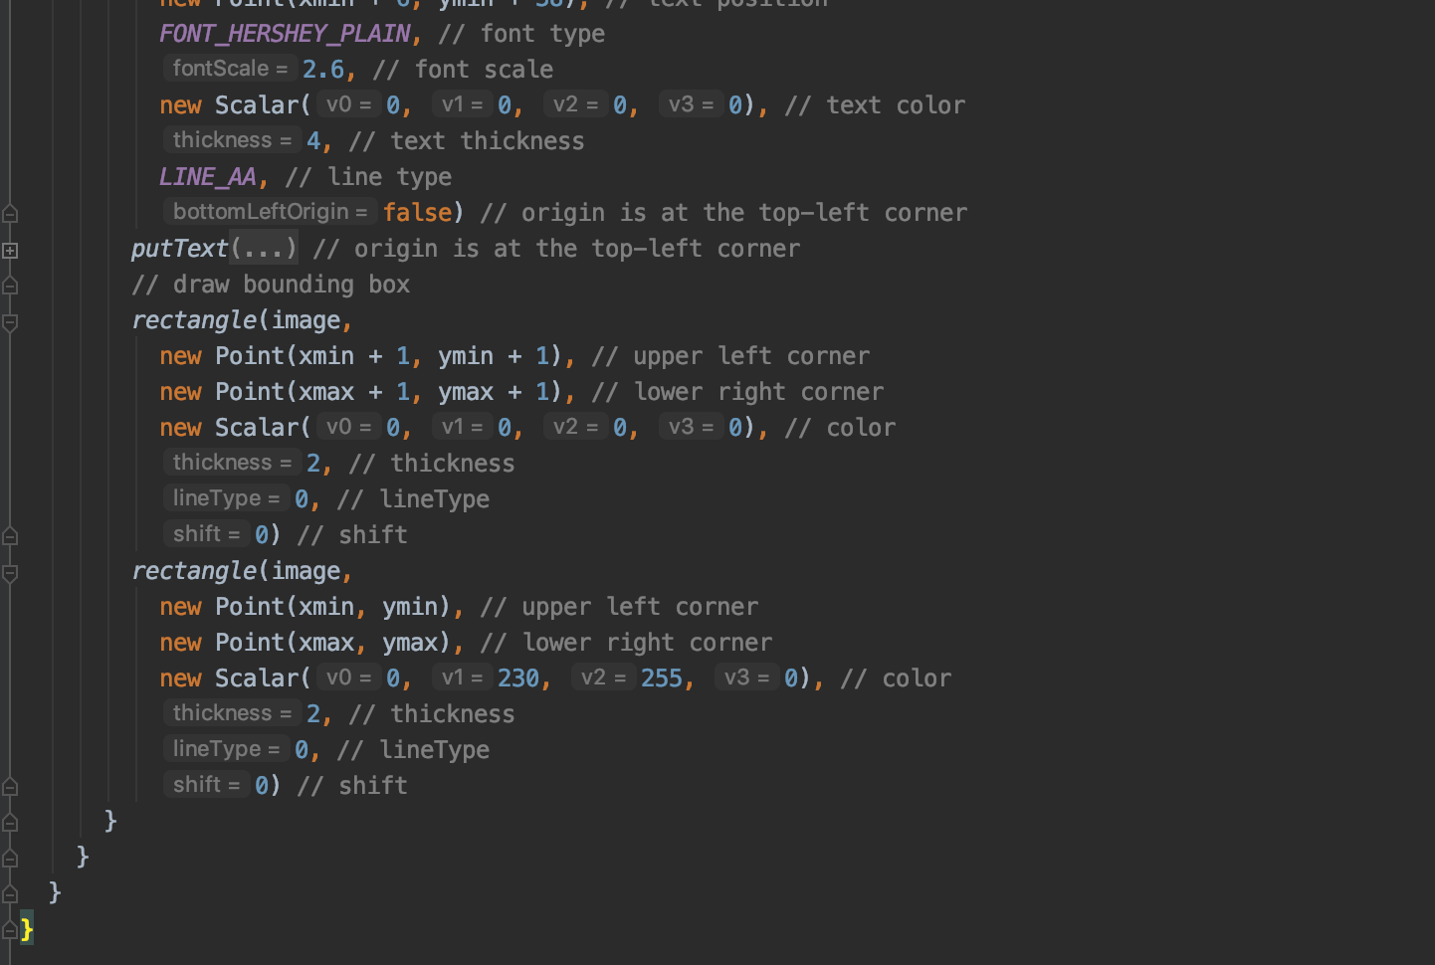
Detecting the object
drawBoundingBoxes:-
Responsible for drawing bounding boxes, scores and classes on top of original image

Slide 28
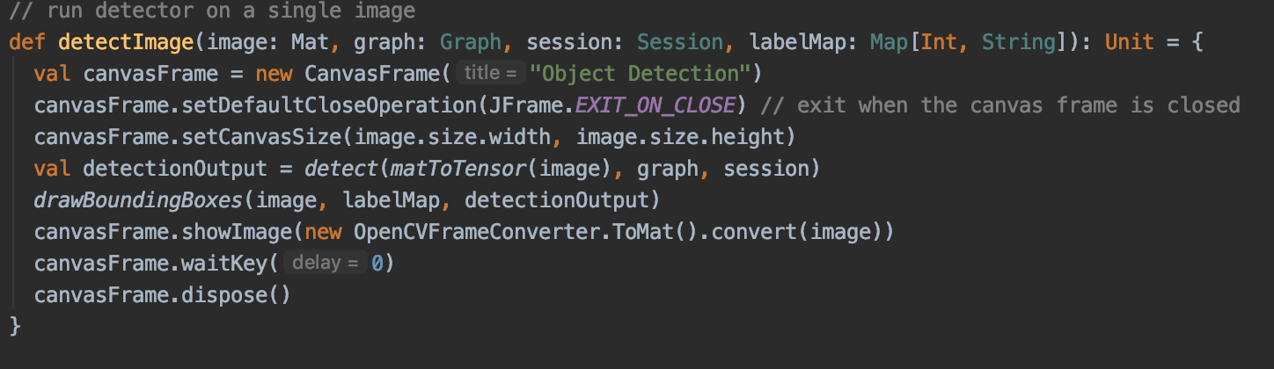
Detecting the object
Displaying results for single image we used JAVA cv.
Canvas frame then call detect and draw bounding boxes

Slide 29
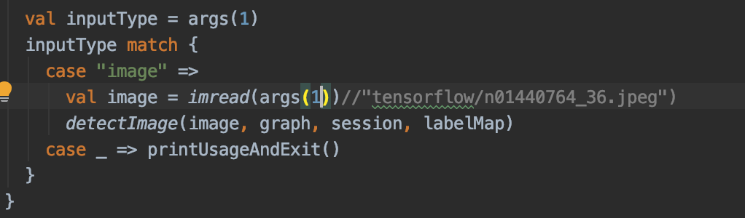
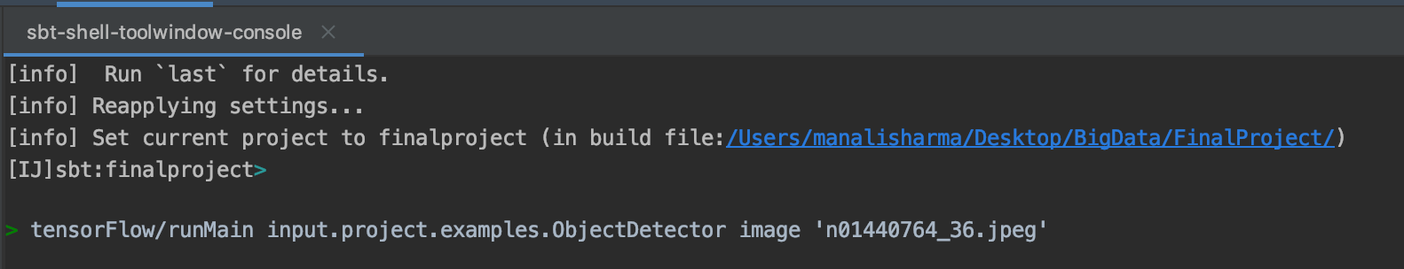
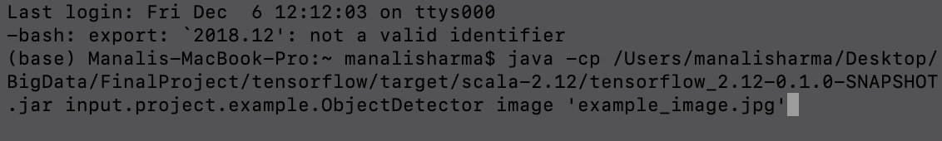
How we are giving inputs ?
SBT terminal with given input image
Running code with shell script

Slide 30
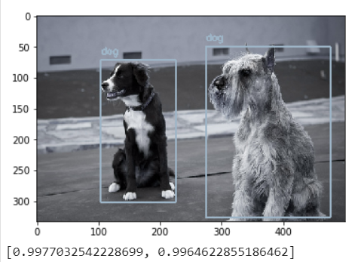
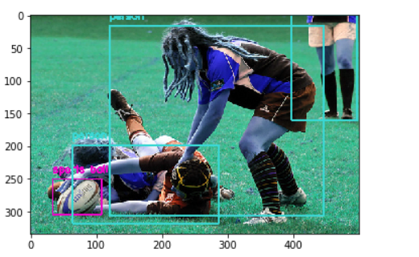
Result

Slide 31
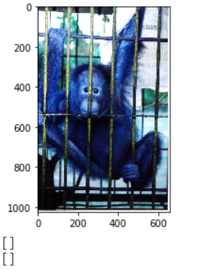
Aberrations

Slide 32
Acceptance criteria-Revisit
Acceptance Criteria:
 | Accuracy | Single Object Detection (Probability) | Multi Object Detection (Probability)
Acceptance Criteria | 80% | 80% | 70%
Actual | 87.50% | 99% | 84%

Slide 33
Challenges and Limitations
Due to the dataset size image classification model training was performed only on 10 classes using 20,000 images.
Due to cost of high end clusters (AWS) we used smaller spark cluster to run the applications.
Even in cluster mode we were running into GC memory overhead issues. Hence used pre trained SSD model to detect object.

Slide 34
Future Scope
Along with object detection, something known as semantic segmentation can also be done. Semantic segmentation is basically a way by which we try to classify each pixel of an image.
Instance segmentation , it is a combination of semantic segmentation and object detection that distinguishes between different objects in same class.
Training of model with deep learning GPU.

Slide 35
Milestones
Nov 17
Data extraction, cleaning and storing
Nov 17
Data extraction, cleaning and storing
Nov 29
Model implementation on testing data set.
Nov 29
Model implementation on testing data set.
Nov 13
Repository setup,
Big data source setup
Nov 13
Repository setup,
Big data source setup
Nov 13
Repository setup,
Big data source setup
Nov 22
Training dataset and validation dataset processing. Algorithm design
Nov 22
Training dataset and validation dataset processing. Algorithm design
Nov 24
Object detection algorithm development
Nov 24
Object detection algorithm development
Dec 5
Result and evaluation
Dec 5
Result and evaluation
Image processing
Image processing
Image processing
Object detection
Nov 20
Images summary and analysis
Nov 20
Images summary and analysis
Nov 27
Model development using training data set.
Nov 27
Model development using training data set.
Matching & evaluation
Matching & evaluation

Slide 36
Thank You!

